Slide 1
Lecture 8:
Spatial Localization and Detection
Lecture 8 -
1
Lecture 8 - 1 Feb 2016Fei-Fei Li & Andrej Karpathy & Justin Johnson

Slide 2
Administrative
Project Proposals were due on Saturday
Homework 2 due Friday 2/5
Homework 1 grades out this week
Midterm will be in-class on Wednesday 2/10
Lecture 8 -
2
Lecture 8 - 1 Feb 2016Fei-Fei Li & Andrej Karpathy & Justin Johnson

Slide 3
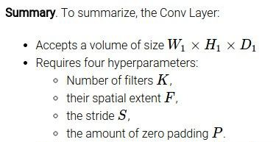
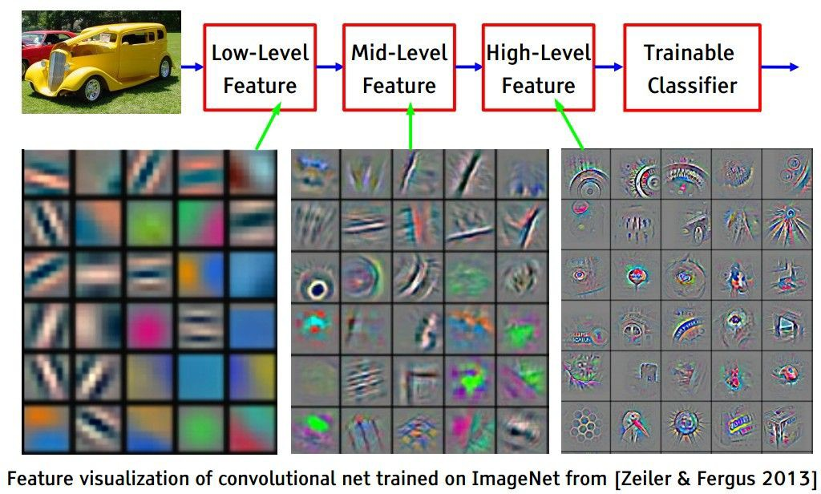
Convolution
32
32
3
Lecture 8 -
3
Lecture 8 - 1 Feb 2016Fei-Fei Li & Andrej Karpathy & Justin Johnson

Slide 4
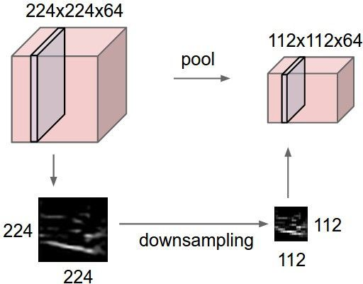
Pooling
1 | 1 | 2 | 4
5 | 6 | 7 | 8
3 | 2 | 1 | 0
1 | 2 | 3 | 4
2x2 max pooling
6 | 8
3 | 4
Lecture 8 -
4
Lecture 8 - 1 Feb 2016Fei-Fei Li & Andrej Karpathy & Justin Johnson

Slide 5
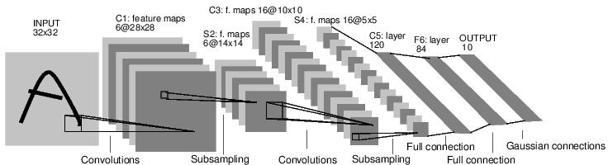
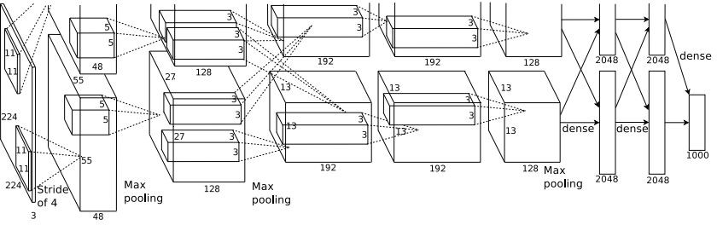
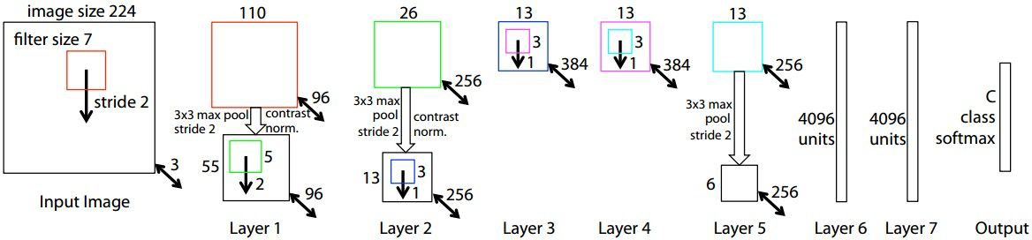
Case Studies
LeNet (1998)
AlexNet (2012)
ZFNet (2013)
Lecture 8 -
5
Lecture 8 - 1 Feb 2016Fei-Fei Li & Andrej Karpathy & Justin Johnson

Slide 6
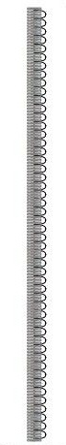
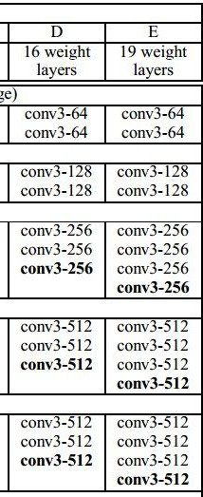
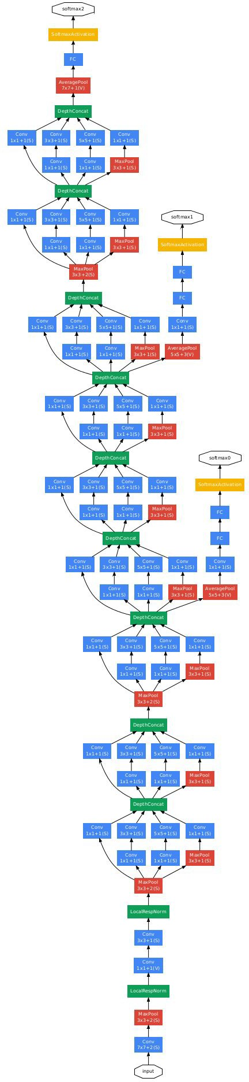
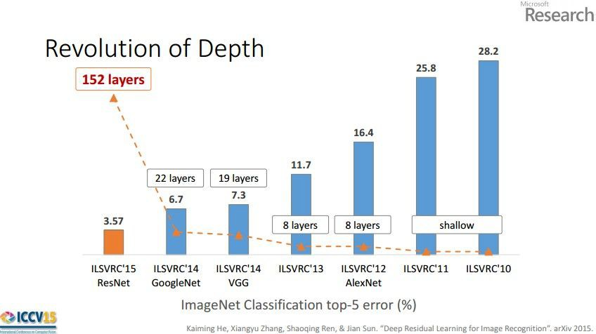
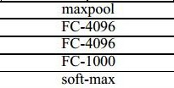
Case Studies
VGG (2014)
GoogLeNet (2014)
ResNet (2015)
Lecture 8 -
6
Lecture 8 - 1 Feb 2016Fei-Fei Li & Andrej Karpathy & Justin Johnson

Slide 7
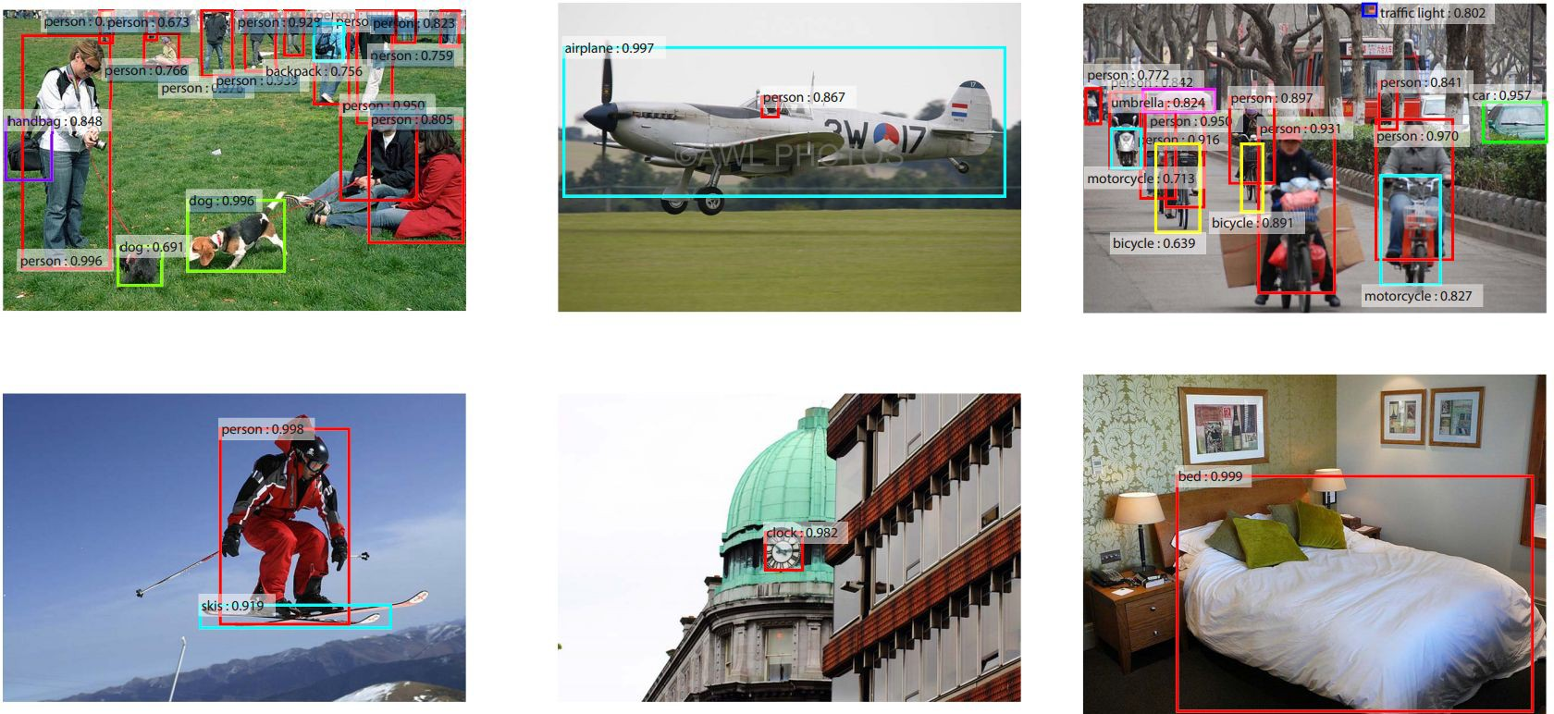
Localization and Detection
Results from Faster R-CNN, Ren et al 2015
Lecture 8 -
7
Lecture 8 - 1 Feb 2016Fei-Fei Li & Andrej Karpathy & Justin Johnson

Slide 8
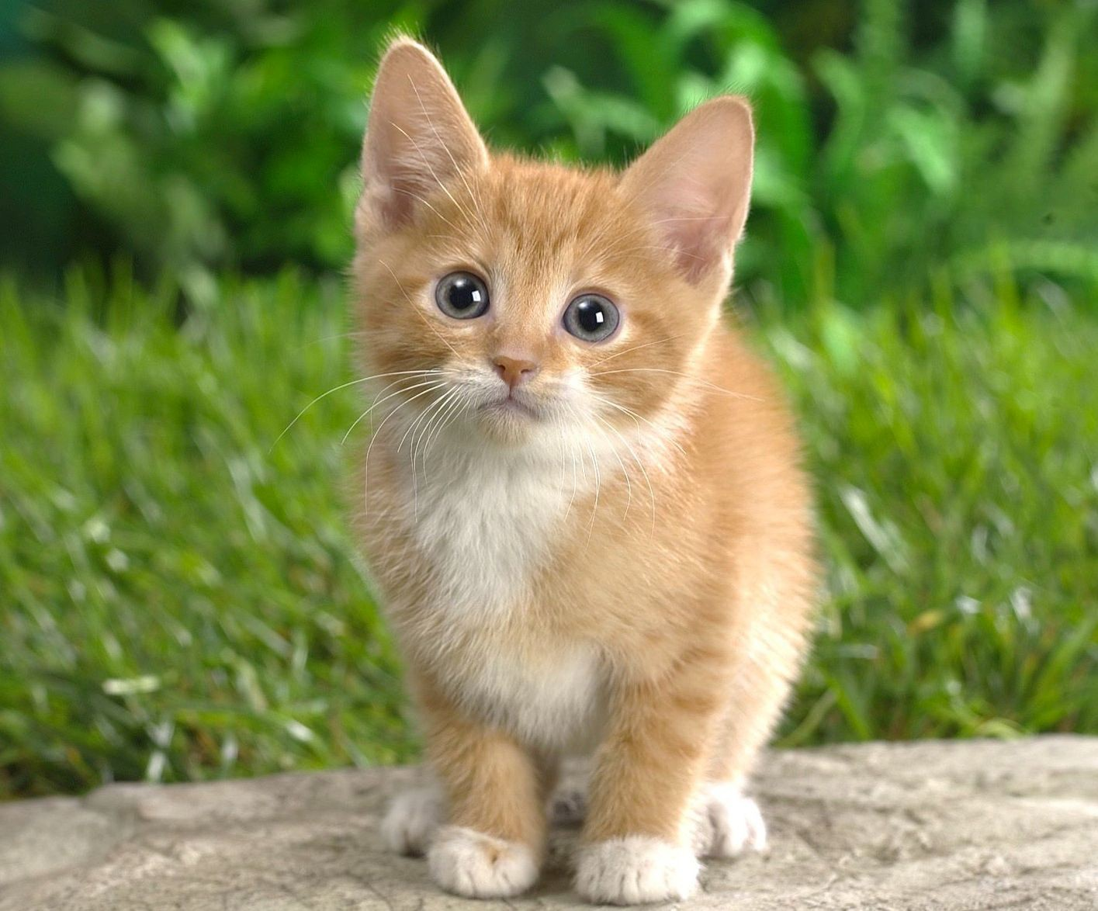

Computer Vision Tasks
Classification
+ Localization
Instance Segmentation
Classification
Object Detection
CAT
CAT
CAT, DOG, DUCK
CAT, DOG, DUCK
Single object
Multiple objects
Lecture 8 -
8
Lecture 8 - 1 Feb 2016Fei-Fei Li & Andrej Karpathy & Justin Johnson

Slide 9


Computer Vision Tasks
Classification
+ Localization
Instance Segmentation
Classification
Object Detection
Lecture 8 -
9
Lecture 8 - 1 Feb 2016Fei-Fei Li & Andrej Karpathy & Justin Johnson

Slide 10
Classification + Localization: Task
Classification: C classes
Input: Image
Output: Class label
Evaluation metric: Accuracy
CAT
Localization:
Input: Image
Output: Box in the image (x, y, w, h)
Evaluation metric: Intersection over Union
(x, y, w, h)
Classification + Localization: Do both
Lecture 8 - 1 Feb 2016Fei-Fei Li & Andrej Karpathy & Justin Johnson

Slide 11
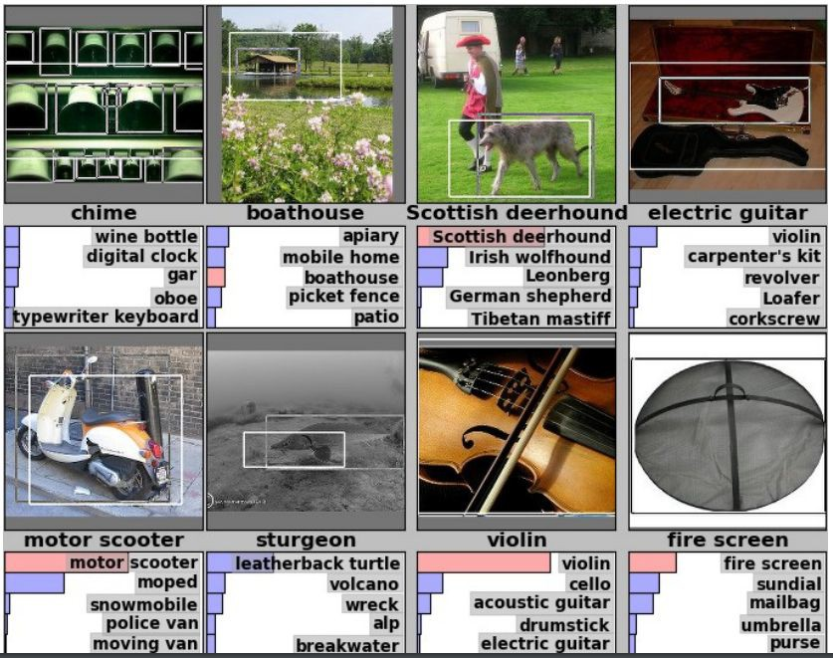
Classification + Localization: ImageNet
1000 classes (same as classification)
Each image has 1 class, at least one bounding box
~800 training images per class
Algorithm produces 5 (class, box) guesses
Example is correct if at least one one guess has correct class AND bounding box at least 0.5 intersection over union (IoU)
Krizhevsky et. al. 2012
Lecture 8 - 1 Feb 2016Fei-Fei Li & Andrej Karpathy & Justin Johnson

Slide 12



Idea #1: Localization as Regression
Input: image
Neural Net
Output:
Box coordinates (4 numbers)
Loss: L2 distance
Correct output: box coordinates (4 numbers)
Only one object, simpler than detection
Lecture 8 - 1 Feb 2016Fei-Fei Li & Andrej Karpathy & Justin Johnson

Slide 13
Simple Recipe for Classification + Localization
Step 1: Train (or download) a classification model (AlexNet, VGG, GoogLeNet)
Convolution and Pooling
Fully-connected layers
Softmax loss
Final conv feature map
Class scores
Image
Lecture 8 - 1 Feb 2016Fei-Fei Li & Andrej Karpathy & Justin Johnson

Slide 14

Simple Recipe for Classification + Localization
Step 2: Attach new fully-connected “regression head” to the network
Fully-connected layers
“Classification head”
Convolution and Pooling
Class scores
Fully-connected layers
“Regression head”
Final conv feature map
Image
Box coordinates
Lecture 8 - 1 Feb 2016Fei-Fei Li & Andrej Karpathy & Justin Johnson

Slide 15
Simple Recipe for Classification + Localization
Step 3: Train the regression head only with SGD and L2 loss
Fully-connected layers
Convolution and Pooling
Class scores
Fully-connected layers
L2 loss
Final conv feature map
Image
Box coordinates
Lecture 8 - 1 Feb 2016Fei-Fei Li & Andrej Karpathy & Justin Johnson

Slide 16
Simple Recipe for Classification + Localization
Step 4: At test time use both heads
Fully-connected layers
Convolution and Pooling
Class scores
Fully-connected layers
Final conv feature map
Image
Box coordinates
Lecture 8 - 1 Feb 2016Fei-Fei Li & Andrej Karpathy & Justin Johnson

Slide 17
Per-class vs class agnostic regression
Assume classification over C classes:
Fully-connected layers
Classification head:
C numbers (one per class)
Convolution and Pooling
Class scores
Class agnostic:
4 numbers (one box)
Class specific:
C x 4 numbers (one box per class)
Fully-connected layers
Final conv feature map
Image
Box coordinates
Lecture 8 - 1 Feb 2016Fei-Fei Li & Andrej Karpathy & Justin Johnson

Slide 18

Where to attach the regression head?
After conv layers: Overfeat, VGG
After last FC layer: DeepPose, R-CNN
Convolution and Pooling
Fully-connected layers
Softmax loss
Final conv feature map
Class scores
Image
Lecture 8 - 1 Feb 2016Fei-Fei Li & Andrej Karpathy & Justin Johnson

Slide 19
Aside: Localizing multiple objects
Want to localize exactly K objects in each image
Fully-connected
(e.g. whole cat, cat head, cat left ear, cat right ear for K=4)
layers
Convolution and Pooling
Class scores
Fully-connected layers
K x 4 numbers
(one box per object)
Final conv feature map
Image
Box coordinates
Lecture 8 - 1 Feb 2016Fei-Fei Li & Andrej Karpathy & Justin Johnson

Slide 20
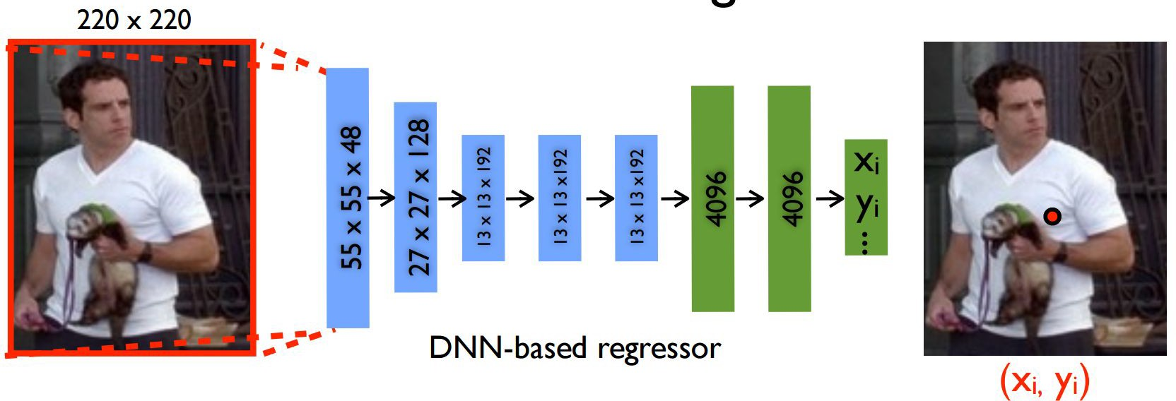
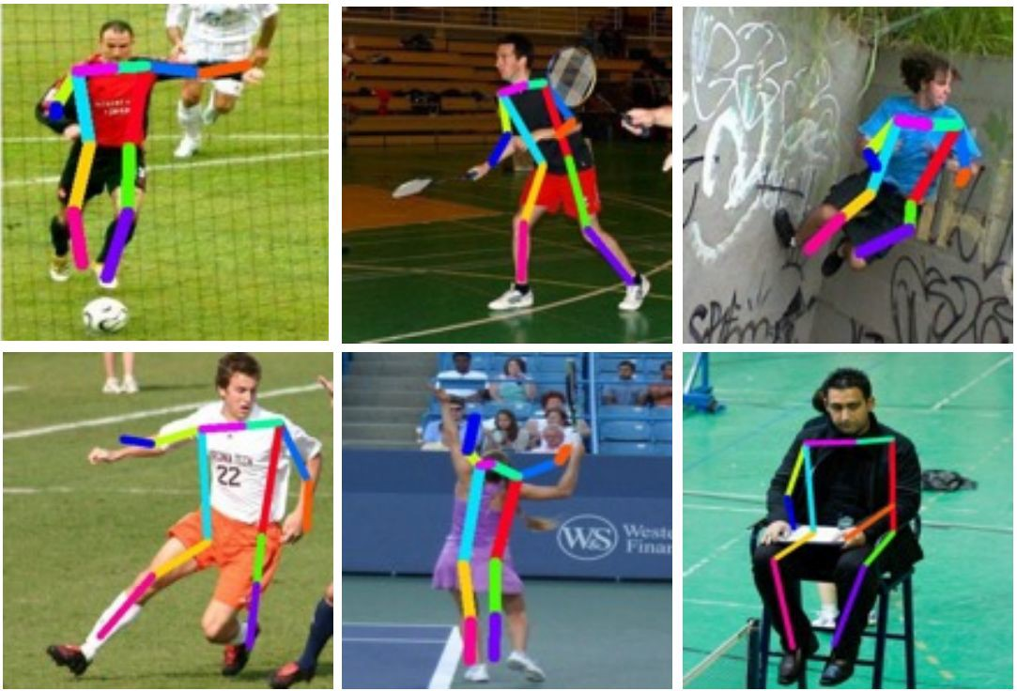
Aside: Human Pose Estimation
Represent a person by K joints
Regress (x, y) for each joint from last fully-connected layer of AlexNet
(Details: Normalized coordinates, iterative refinement)
Toshev and Szegedy, “DeepPose: Human Pose Estimation via Deep Neural Networks”, CVPR 2014
Lecture 8 - 1 Feb 2016Fei-Fei Li & Andrej Karpathy & Justin Johnson

Slide 21
Localization as Regression
Very simple
Think if you can use this for projects
Lecture 8 - 1 Feb 2016Fei-Fei Li & Andrej Karpathy & Justin Johnson

Slide 22
Idea #2: Sliding Window
Run classification + regression network at multiple locations on a high- resolution image
Convert fully-connected layers into convolutional layers for efficient computation
Combine classifier and
regressor predictions across all scales for final prediction
Lecture 8 - 1 Feb 2016Fei-Fei Li & Andrej Karpathy & Justin Johnson

Slide 23
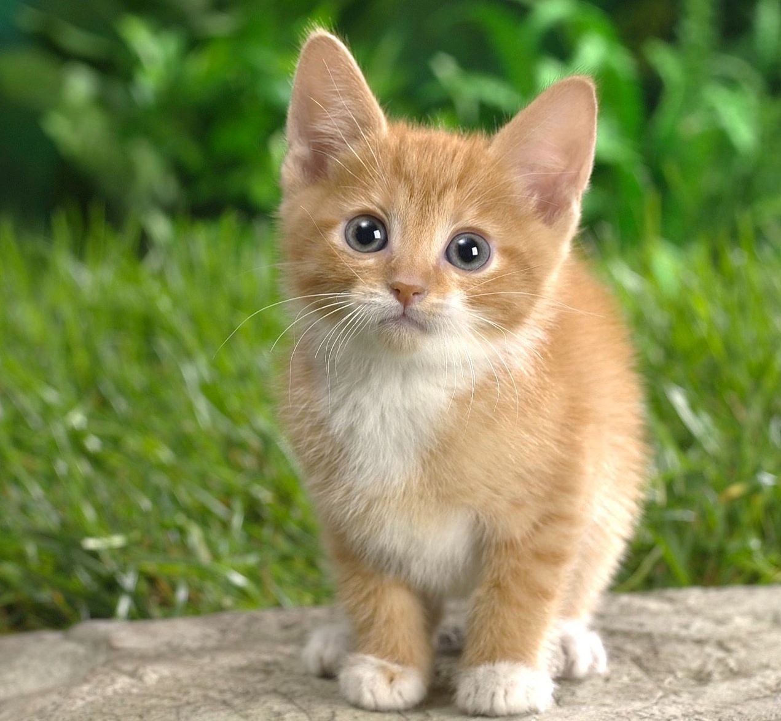
Sliding Window: Overfeat
4096
4096
Class scores: 1000
Winner of ILSVRC 2013 localization challenge
FC
FC
Convolution
+ pooling
Softmax loss
FC
FC
Feature map: 1024 x 5 x 5
FC
FC
Image:
3 x 221 x 221
Euclidean loss
1024
Boxes: 1000 x 4
Sermanet et al, “Integrated Recognition, Localization and Detection using Convolutional Networks”, ICLR 2014
4096
Lecture 8 - 1 Feb 2016Fei-Fei Li & Andrej Karpathy & Justin Johnson

Slide 24
Sliding Window: Overfeat
Network input: 3 x 221 x 221
Larger image: 3 x 257 x 257
Lecture 8 - 1 Feb 2016Fei-Fei Li & Andrej Karpathy & Justin Johnson

Slide 25
Sliding Window: Overfeat
0.5
Network input: 3 x 221 x 221
Larger image: 3 x 257 x 257
Classification scores: P(cat)
Lecture 8 - 1 Feb 2016Fei-Fei Li & Andrej Karpathy & Justin Johnson

Slide 26
Sliding Window: Overfeat
0.5 | 0.75
Network input: 3 x 221 x 221
Larger image: 3 x 257 x 257
Classification scores: P(cat)
Lecture 8 - 1 Feb 2016Fei-Fei Li & Andrej Karpathy & Justin Johnson

Slide 27
Sliding Window: Overfeat
0.5 | 0.75
0.6
Network input: 3 x 221 x 221
Larger image: 3 x 257 x 257
Classification scores: P(cat)
Lecture 8 - 1 Feb 2016Fei-Fei Li & Andrej Karpathy & Justin Johnson

Slide 28
Sliding Window: Overfeat
0.5 | 0.75
0.6 | 0.8
Network input: 3 x 221 x 221
Larger image: 3 x 257 x 257
Classification scores: P(cat)
Lecture 8 - 1 Feb 2016Fei-Fei Li & Andrej Karpathy & Justin Johnson

Slide 29
Sliding Window: Overfeat
0.5 | 0.75
0.6 | 0.8
Network input: 3 x 221 x 221
Larger image: 3 x 257 x 257
Classification scores: P(cat)
Lecture 8 - 1 Feb 2016Fei-Fei Li & Andrej Karpathy & Justin Johnson

Slide 30
Sliding Window: Overfeat
Greedily merge boxes and scores (details in paper)
0.8
Network input: 3 x 221 x 221
Larger image: 3 x 257 x 257
Classification score: P (cat)
Lecture 8 - 1 Feb 2016Fei-Fei Li & Andrej Karpathy & Justin Johnson

Slide 31
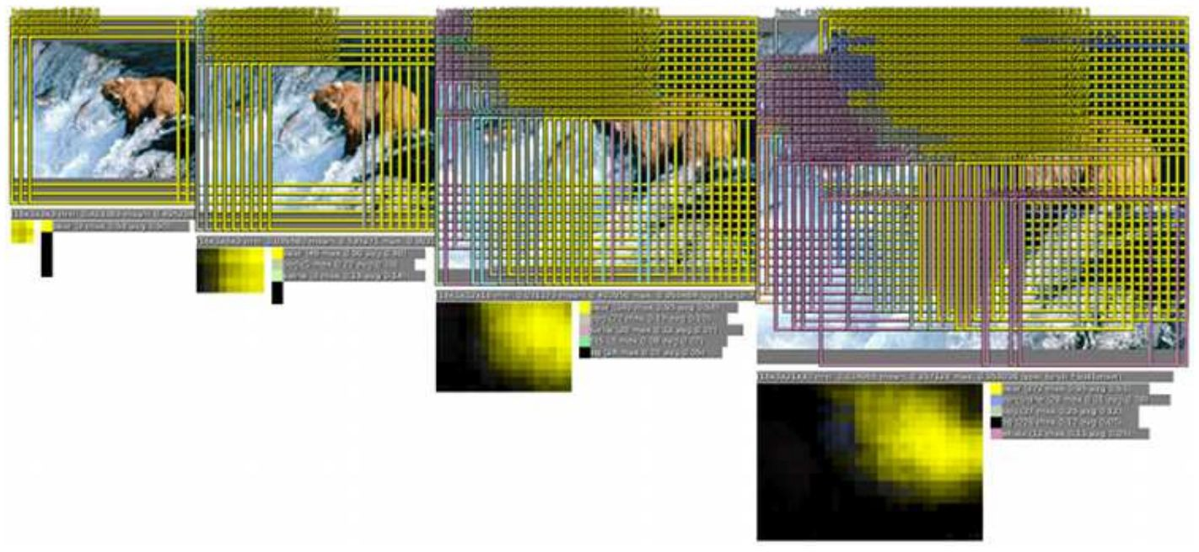
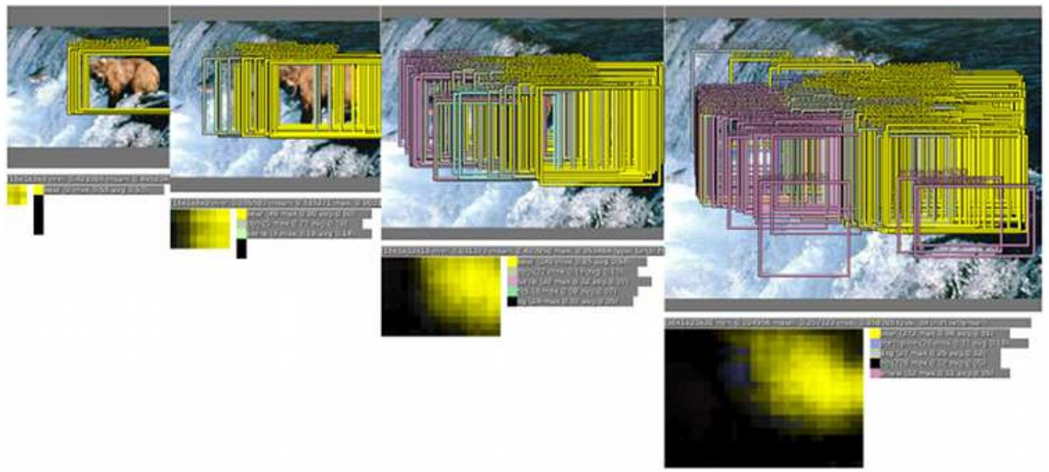
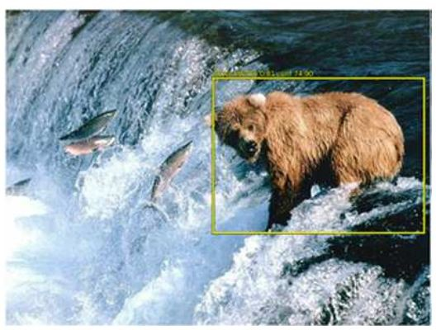
Sliding Window: Overfeat
In practice use many sliding window locations and multiple scales
Window positions + score maps
Box regression outputs
Final Predictions
Sermanet et al, “Integrated Recognition, Localization and Detection using Convolutional Networks”, ICLR 2014
Lecture 8 - 1 Feb 2016Fei-Fei Li & Andrej Karpathy & Justin Johnson

Slide 32
Efficient Sliding Window: Overfeat
4096 4096
Class scores: 1000
FC
FC
Convolution
+ pooling
FC
FC
Feature map: 1024 x 5 x 5
FC
FC
Image:
3 x 221 x 221
1024
Boxes: 1000 x 4
4096
Lecture 8 - 1 Feb 2016Fei-Fei Li & Andrej Karpathy & Justin Johnson

Slide 33
Efficient Sliding Window: Overfeat
Efficient sliding window by converting fully- connected layers into convolutions
4096 x 1 x 1
Class scores: 1000 x 1 x 1
1024 x 1 x 1
Convolution
+ pooling
1 x 1 conv
1 x 1 conv
5 x 5 conv
5 x 5 conv
Feature map: 1024 x 5 x 5
1 x 1 conv
1 x 1 conv
Image:
3 x 221 x 221
4096 x 1 x 1
1024 x 1 x 1
Box coordinates: (4 x 1000) x 1 x 1
Lecture 8 - 1 Feb 2016Fei-Fei Li & Andrej Karpathy & Justin Johnson

Slide 34
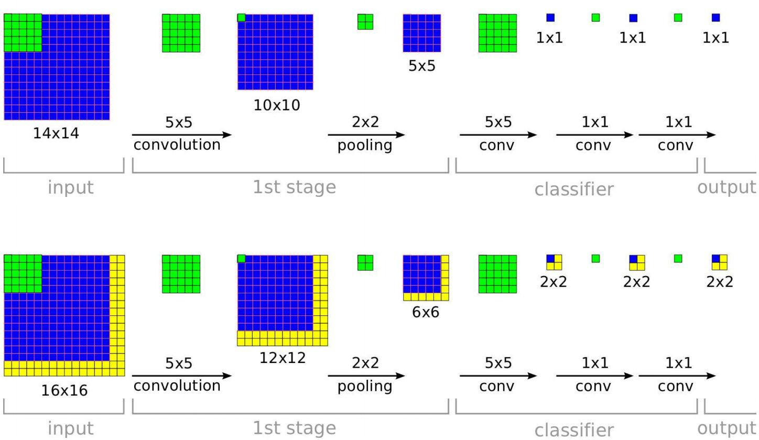
Efficient Sliding Window: Overfeat
Training time: Small image, 1 x 1 classifier output
Test time: Larger image, 2 x 2 classifier output, only extra compute at yellow regions
Sermanet et al, “Integrated Recognition, Localization and Detection using Convolutional Networks”, ICLR 2014
Lecture 8 - 1 Feb 2016Fei-Fei Li & Andrej Karpathy & Justin Johnson

Slide 35
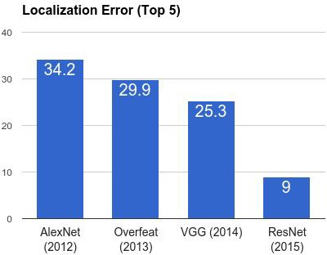
ImageNet Classification + Localization
AlexNet: Localization method not published
Overfeat: Multiscale convolutional regression with box merging
VGG: Same as Overfeat, but fewer scales and locations; simpler method, gains all due to deeper features
ResNet: Different localization method (RPN) and much deeper features
Lecture 8 - 1 Feb 2016Fei-Fei Li & Andrej Karpathy & Justin Johnson

Slide 36
Computer Vision Tasks
Classification
+ Localization
Instance Segmentation
Classification
Object Detection
Lecture 8 - 1 Feb 2016Fei-Fei Li & Andrej Karpathy & Justin Johnson

Slide 37
Computer Vision Tasks
Classification
+ Localization
Instance Segmentation
Classification
Object Detection
Lecture 8 - 1 Feb 2016Fei-Fei Li & Andrej Karpathy & Justin Johnson

Slide 38
Detection as Regression?
DOG, (x, y, w, h)
CAT, (x, y, w, h)
CAT, (x, y, w, h)
DUCK (x, y, w, h)
= 16 numbers
Lecture 8 - 1 Feb 2016Fei-Fei Li & Andrej Karpathy & Justin Johnson

Slide 39

Detection as Regression?
DOG, (x, y, w, h)
CAT, (x, y, w, h)
= 8 numbers
Lecture 8 - 1 Feb 2016Fei-Fei Li & Andrej Karpathy & Justin Johnson

Slide 40
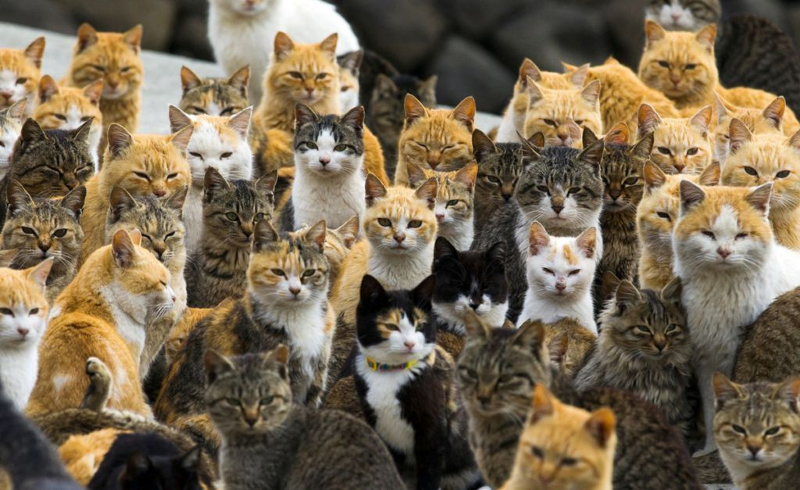
Detection as Regression?
CAT, (x, y, w, h)
CAT, (x, y, w, h)
….
CAT (x, y, w, h)
= many numbers
Need variable sized outputs
Lecture 8 - 1 Feb 2016Fei-Fei Li & Andrej Karpathy & Justin Johnson

Slide 41
Detection as Classification
CAT? NO
DOG? NO
Lecture 8 - 1 Feb 2016Fei-Fei Li & Andrej Karpathy & Justin Johnson

Slide 42
Detection as Classification
CAT? YES!
DOG? NO
Lecture 8 - 1 Feb 2016Fei-Fei Li & Andrej Karpathy & Justin Johnson

Slide 43
Detection as Classification
CAT? NO
DOG? NO
Lecture 8 - 1 Feb 2016Fei-Fei Li & Andrej Karpathy & Justin Johnson

Slide 44
Detection as Classification
Problem: Need to test many positions and scales
Solution: If your classifier is fast enough, just do it
Lecture 8 - 1 Feb 2016Fei-Fei Li & Andrej Karpathy & Justin Johnson

Slide 45
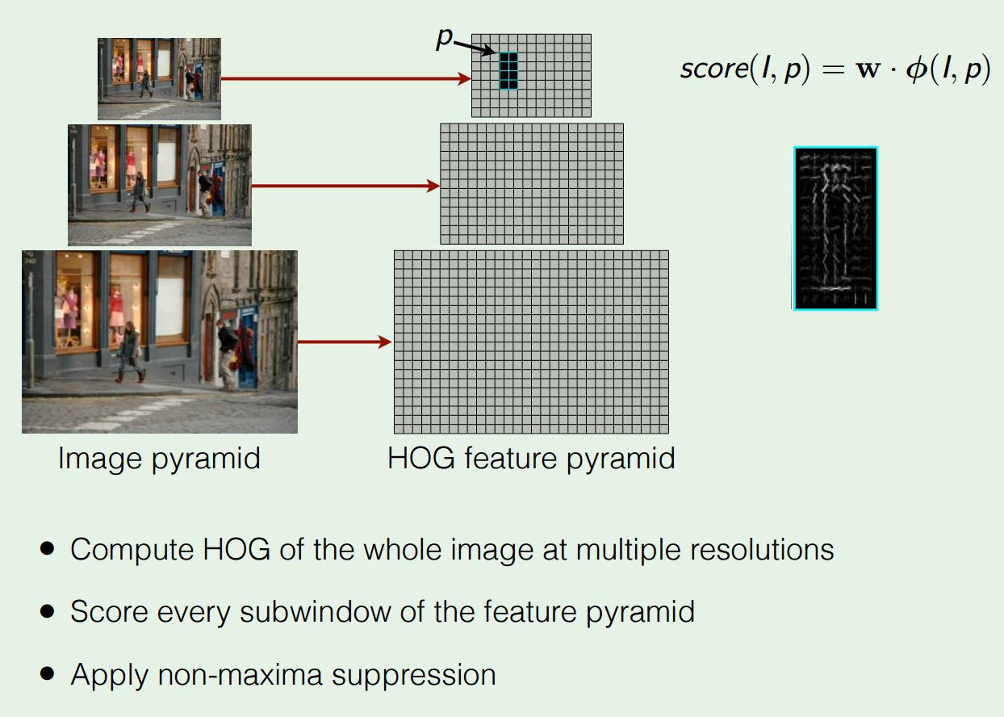
Histogram of Oriented Gradients
Dalal and Triggs, “Histograms of Oriented Gradients for Human Detection”, CVPR 2005 Slide credit: Ross Girshick
Lecture 8 - 1 Feb 2016Fei-Fei Li & Andrej Karpathy & Justin Johnson

Slide 46
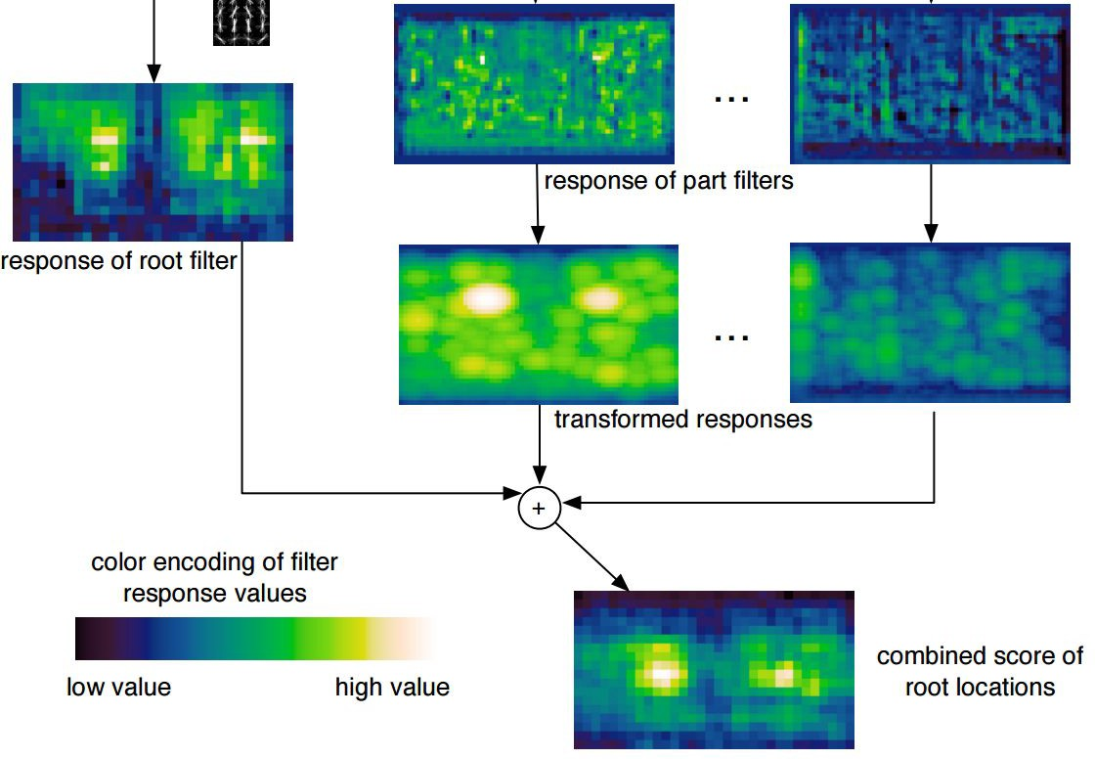
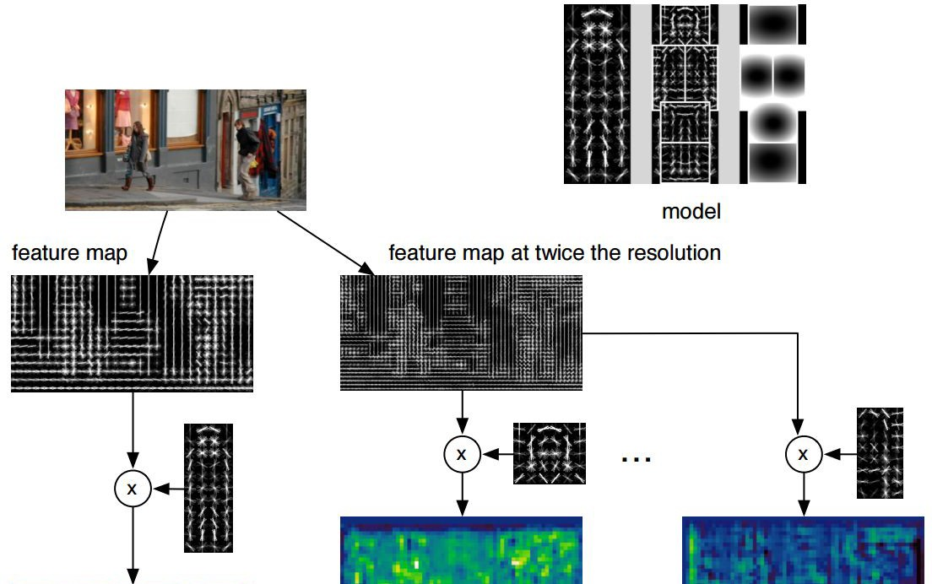
Deformable Parts Model (DPM)
Felzenszwalb et al, “Object Detection with Discriminatively Trained Part Based Models”, PAMI 2010
Lecture 8 - 1 Feb 2016Fei-Fei Li & Andrej Karpathy & Justin Johnson

Slide 47
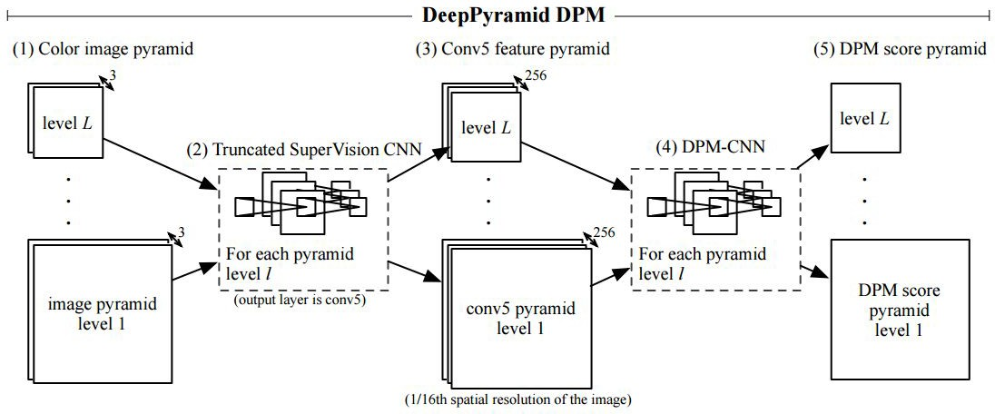
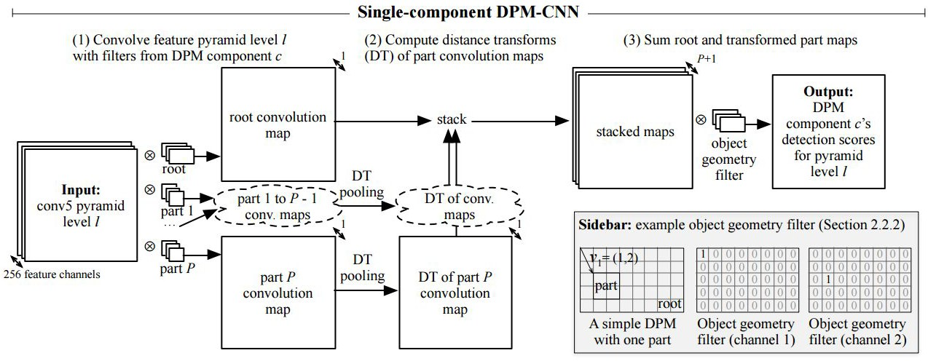
Aside: Deformable Parts Models are CNNs?
Girschick et al, “Deformable Part Models are Convolutional Neural Networks”, CVPR 2015
Lecture 8 - 1 Feb 2016Fei-Fei Li & Andrej Karpathy & Justin Johnson

Slide 48
Detection as Classification
Problem: Need to test many positions and scales, and use a computationally demanding classifier (CNN)
Solution: Only look at a tiny subset of possible positions
Lecture 8 - 1 Feb 2016Fei-Fei Li & Andrej Karpathy & Justin Johnson

Slide 49
Region Proposals
Find “blobby” image regions that are likely to contain objects
“Class-agnostic” object detector
Look for “blob-like” regions
Lecture 8 - 1 Feb 2016Fei-Fei Li & Andrej Karpathy & Justin Johnson

Slide 50
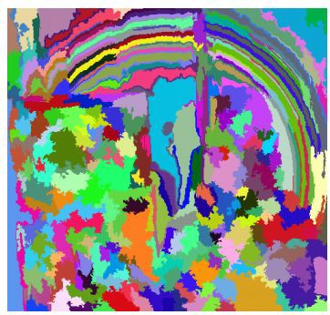
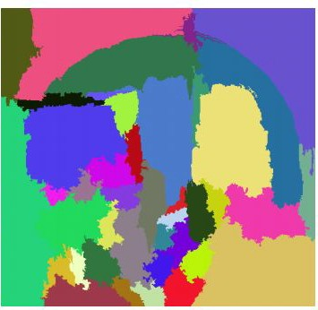
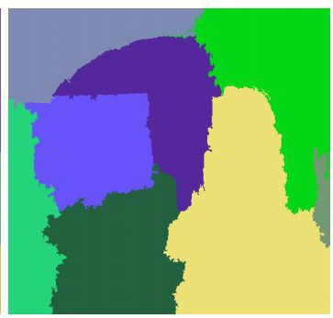
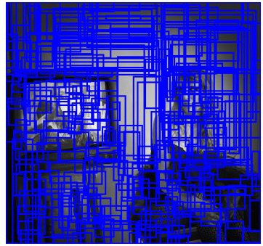
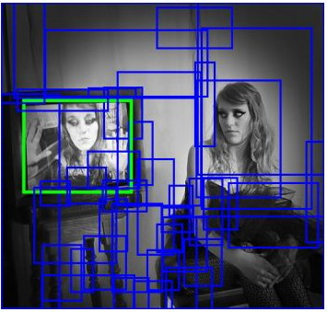
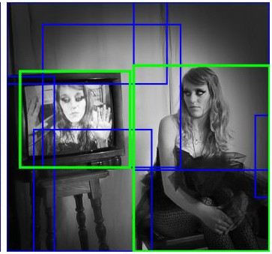
Region Proposals: Selective Search
Bottom-up segmentation, merging regions at multiple scales
Convert regions to boxes
Uijlings et al, “Selective Search for Object Recognition”, IJCV 2013
Lecture 8 - 1 Feb 2016Fei-Fei Li & Andrej Karpathy & Justin Johnson

Slide 51
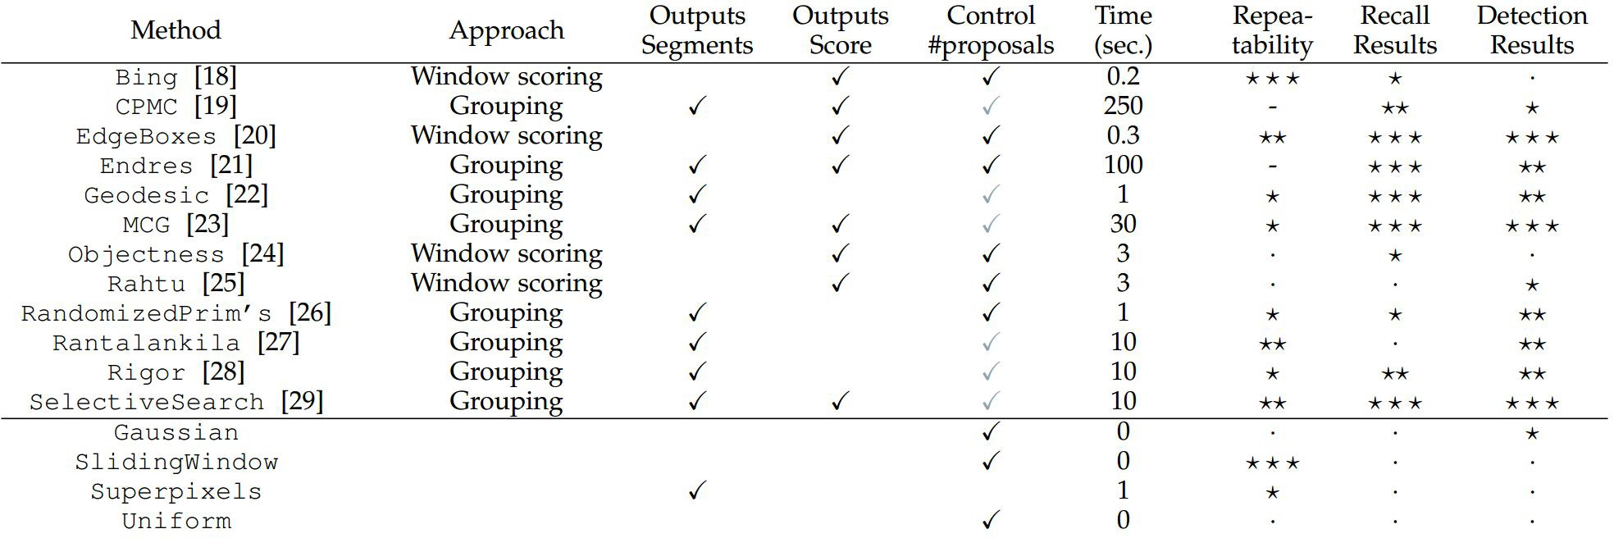
Region Proposals: Many other choices
Hosang et al, “What makes for effective detection proposals?”, PAMI 2015
Lecture 8 - 1 Feb 2016Fei-Fei Li & Andrej Karpathy & Justin Johnson

Slide 52
Region Proposals: Many other choices
Hosang et al, “What makes for effective detection proposals?”, PAMI 2015
Lecture 8 - 1 Feb 2016Fei-Fei Li & Andrej Karpathy & Justin Johnson

Slide 53
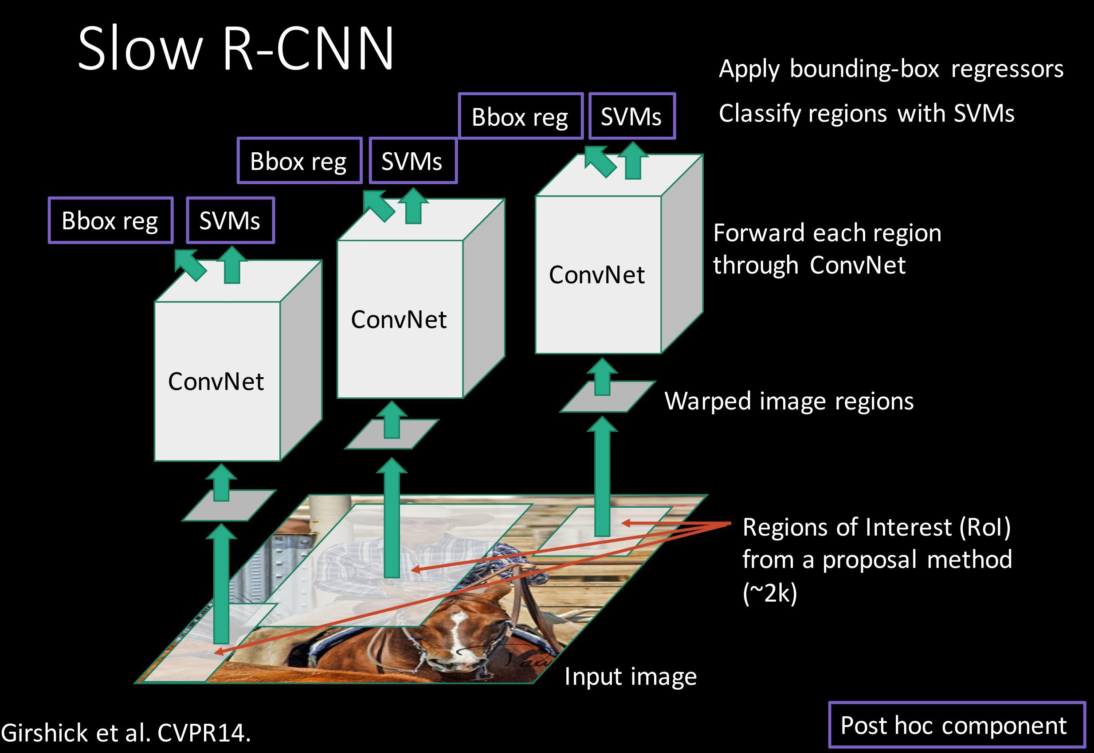
Putting it together: R-CNN
Girschick et al, “Rich feature hierarchies for accurate object detection and semantic segmentation”, CVPR 2014
Slide credit: Ross Girschick
Lecture 8 - 1 Feb 2016Fei-Fei Li & Andrej Karpathy & Justin Johnson

Slide 54
R-CNN Training
Step 1: Train (or download) a classification model for ImageNet (AlexNet)
Convolution and Pooling
Fully-connected layers
Softmax loss
Final conv feature map
Class scores 1000 classes
Image
Lecture 8 - 1 Feb 2016Fei-Fei Li & Andrej Karpathy & Justin Johnson

Slide 55
R-CNN Training
Step 2: Fine-tune model for detection
Instead of 1000 ImageNet classes, want 20 object classes + background
Throw away final fully-connected layer, reinitialize from scratch
Keep training model using positive / negative regions from detection images
Re-initialize this layer: was 4096 x 1000,
now will be 4096 x 21
Convolution and Pooling
Fully-connected layers
Softmax loss
Final conv feature map
Class scores: 21 classes
Image
Lecture 8 - 1 Feb 2016Fei-Fei Li & Andrej Karpathy & Justin Johnson

Slide 56

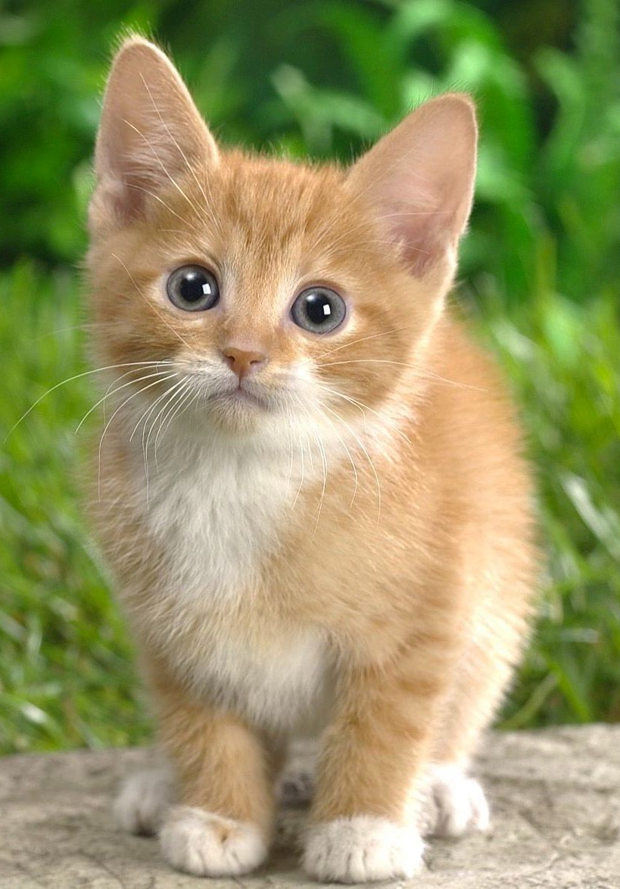
R-CNN Training
Step 3: Extract features
Extract region proposals for all images
For each region: warp to CNN input size, run forward through CNN, save pool5 features to disk
Have a big hard drive: features are ~200GB for PASCAL dataset!
Convolution and Pooling
pool5 features
Image
Region Proposals
Crop + Warp
Forward pass
Save to disk
Lecture 8 - 1 Feb 2016Fei-Fei Li & Andrej Karpathy & Justin Johnson

Slide 57

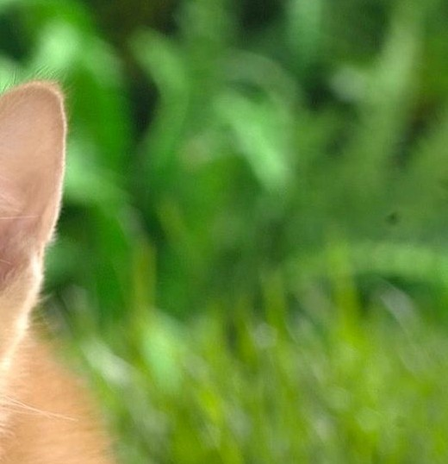
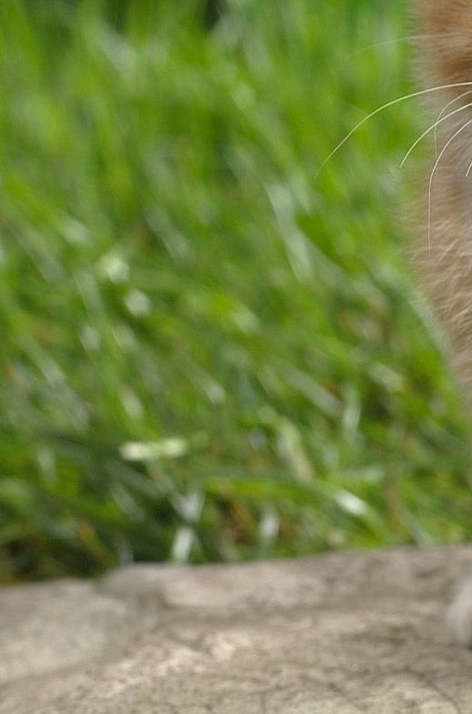
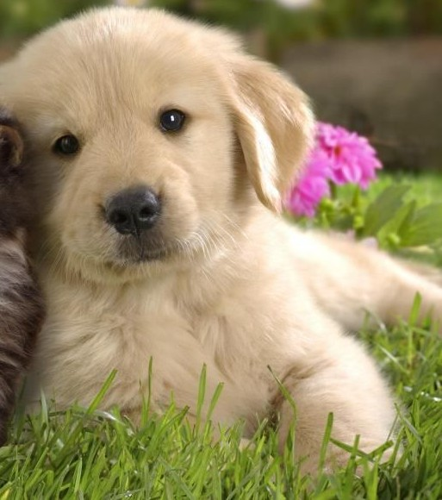
R-CNN Training
Step 4: Train one binary SVM per class to classify region features
Training image regions
Cached region features
Positive samples for cat SVM
Negative samples for cat SVM
Lecture 8 - 1 Feb 2016Fei-Fei Li & Andrej Karpathy & Justin Johnson

Slide 58
R-CNN Training
Step 4: Train one binary SVM per class to classify region features
Training image regions
Cached region features
Negative samples for dog SVM
Positive samples for dog SVM
Lecture 8 - 1 Feb 2016Fei-Fei Li & Andrej Karpathy & Justin Johnson

Slide 59
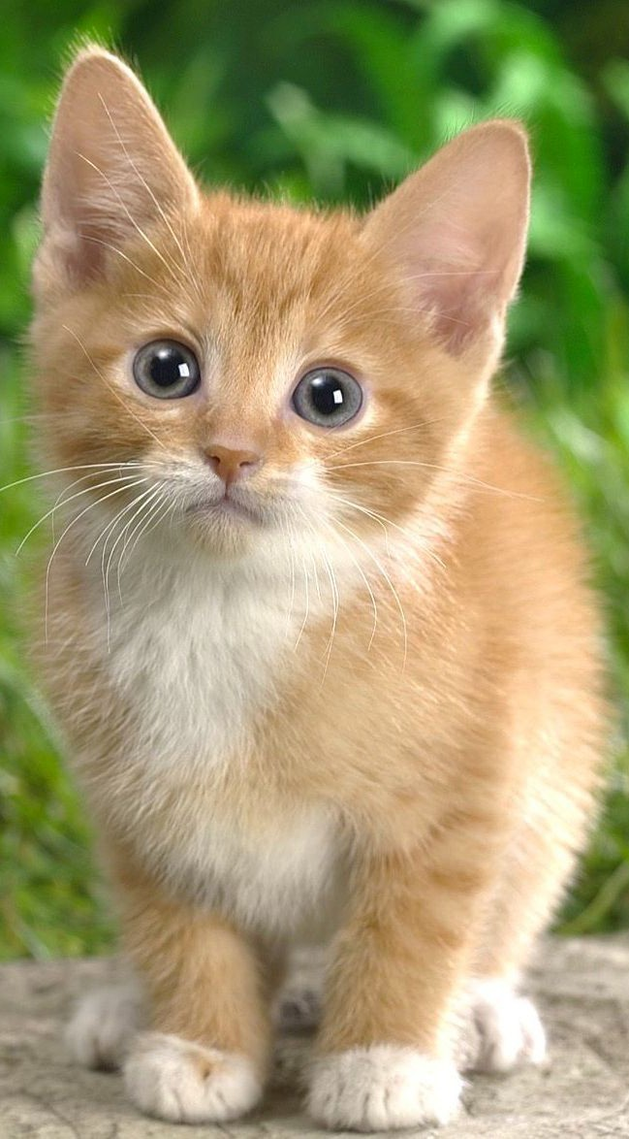

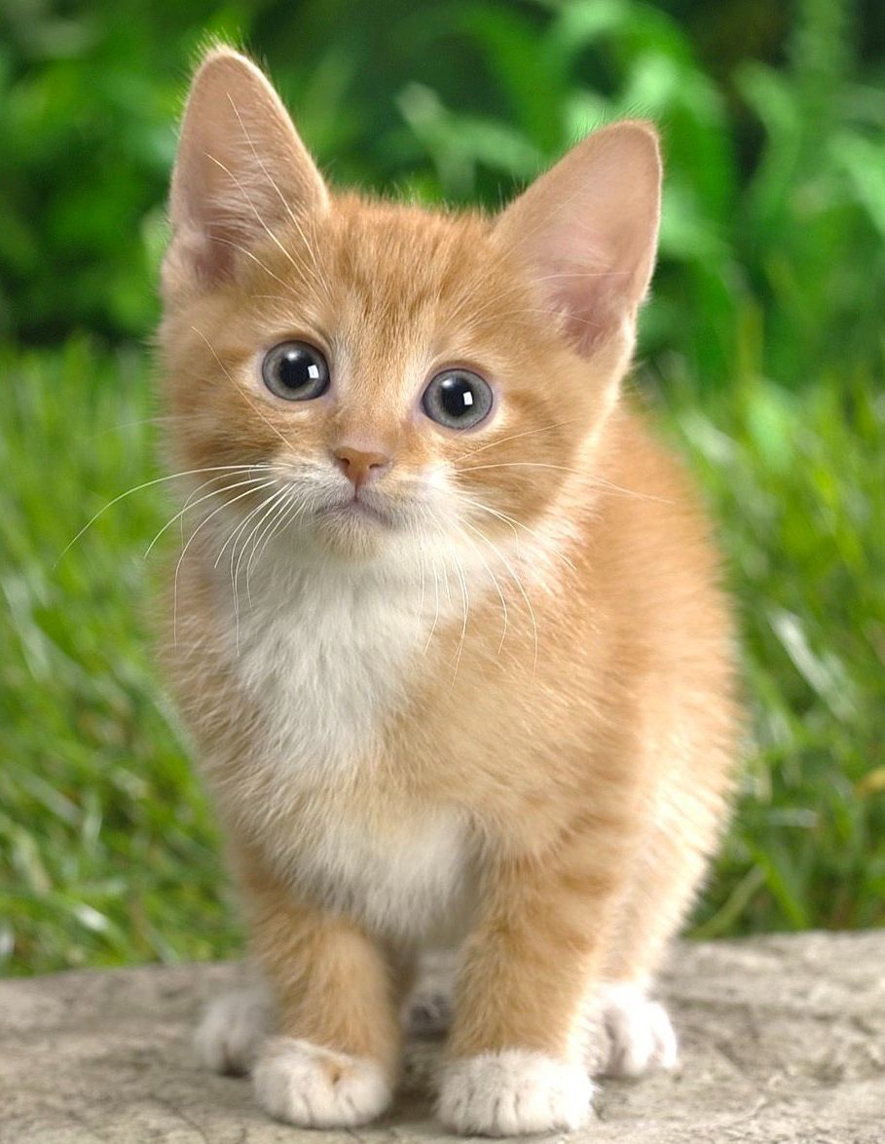
R-CNN Training
Step 5 (bbox regression): For each class, train a linear regression model to map from cached features to offsets to GT boxes to make up for “slightly wrong” proposals
Training image regions
Cached region features
Regression targets (dx, dy, dw, dh)
Normalized coordinates
(0, 0, 0, 0)
Proposal is good
(.25, 0, 0, 0)
Proposal too far to left
(0, 0, -0.125, 0)
Proposal too wide
Lecture 8 - 1 Feb 2016Fei-Fei Li & Andrej Karpathy & Justin Johnson

Slide 60
Object Detection: Datasets
 | PASCAL VOC (2010) | ImageNet Detection (ILSVRC 2014) | MS-COCO (2014)
Number of classes | 20 | 200 | 80
Number of images (train + val) | ~20k | ~470k | ~120k
Mean objects per image | 2.4 | 1.1 | 7.2
Lecture 8 - 1 Feb 2016Fei-Fei Li & Andrej Karpathy & Justin Johnson

Slide 61
Object Detection: Evaluation
We use a metric called “mean average precision” (mAP)
Compute average precision (AP) separately for each class, then average over classes
A detection is a true positive if it has IoU with a ground-truth box greater than some threshold (usually 0.5) (mAP@0.5)
Combine all detections from all test images to draw a precision / recall curve for each class; AP is area under the curve
TL;DR mAP is a number from 0 to 100; high is good
Lecture 8 - 1 Feb 2016Fei-Fei Li & Andrej Karpathy & Justin Johnson

Slide 62
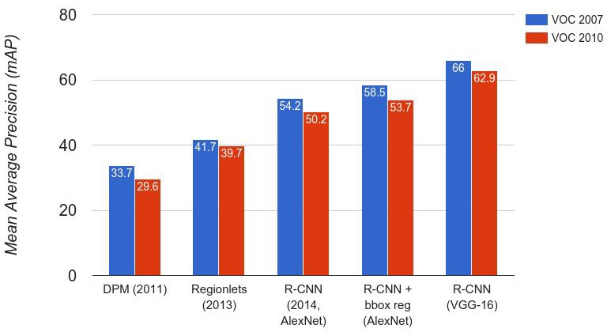
R-CNN Results
Wang et al, “Regionlets for Generic Object Detection”, ICCV 2013
Lecture 8 - 1 Feb 2016Fei-Fei Li & Andrej Karpathy & Justin Johnson

Slide 63
R-CNN Results
Big improvement compared to pre-CNN methods
Lecture 8 - 1 Feb 2016Fei-Fei Li & Andrej Karpathy & Justin Johnson

Slide 64
R-CNN Results
Bounding box regression helps a bit
Lecture 8 - 1 Feb 2016Fei-Fei Li & Andrej Karpathy & Justin Johnson

Slide 65
R-CNN Results
Features from a deeper network help a lot
Lecture 8 - 1 Feb 2016Fei-Fei Li & Andrej Karpathy & Justin Johnson

Slide 66
R-CNN Problems
Slow at test-time: need to run full forward pass of CNN for each region proposal
SVMs and regressors are post-hoc: CNN features not updated in response to SVMs and regressors
Complex multistage training pipeline
Lecture 8 - 1 Feb 2016Fei-Fei Li & Andrej Karpathy & Justin Johnson

Slide 67
Girschick, “Fast R-CNN”, ICCV 2015
Slide credit: Ross Girschick
Lecture 8 - 1 Feb 2016Fei-Fei Li & Andrej Karpathy & Justin Johnson

Slide 68
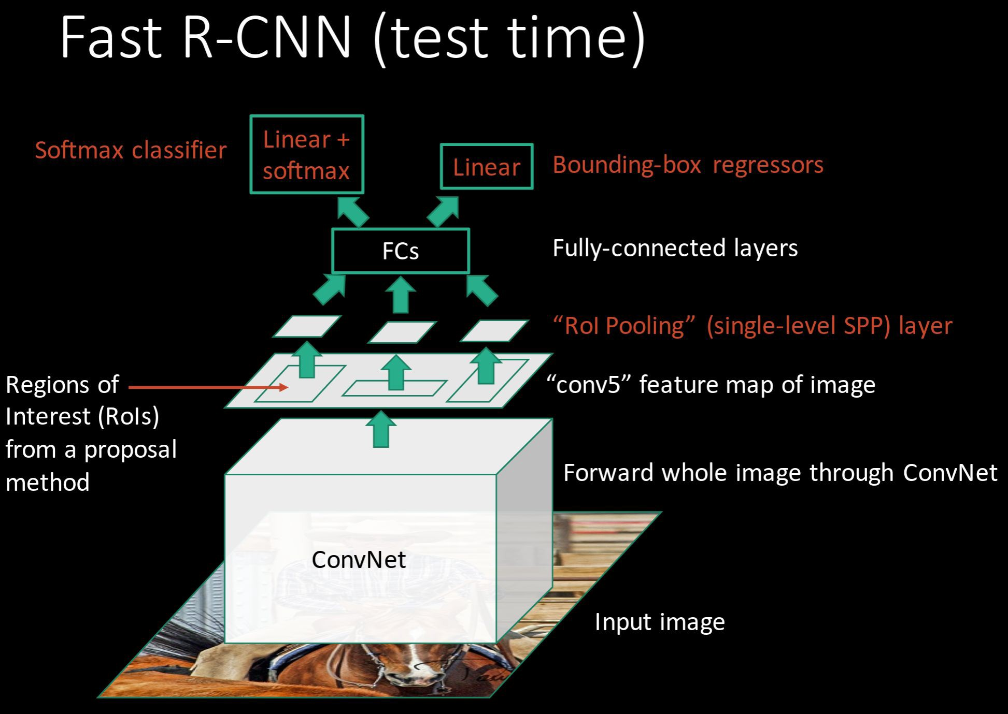
R-CNN Problem #1: Slow at test-time due to independent forward passes of the CNN
Solution:
Share computation of convolutional layers between proposals for an image
Lecture 8 - 1 Feb 2016Fei-Fei Li & Andrej Karpathy & Justin Johnson

Slide 69
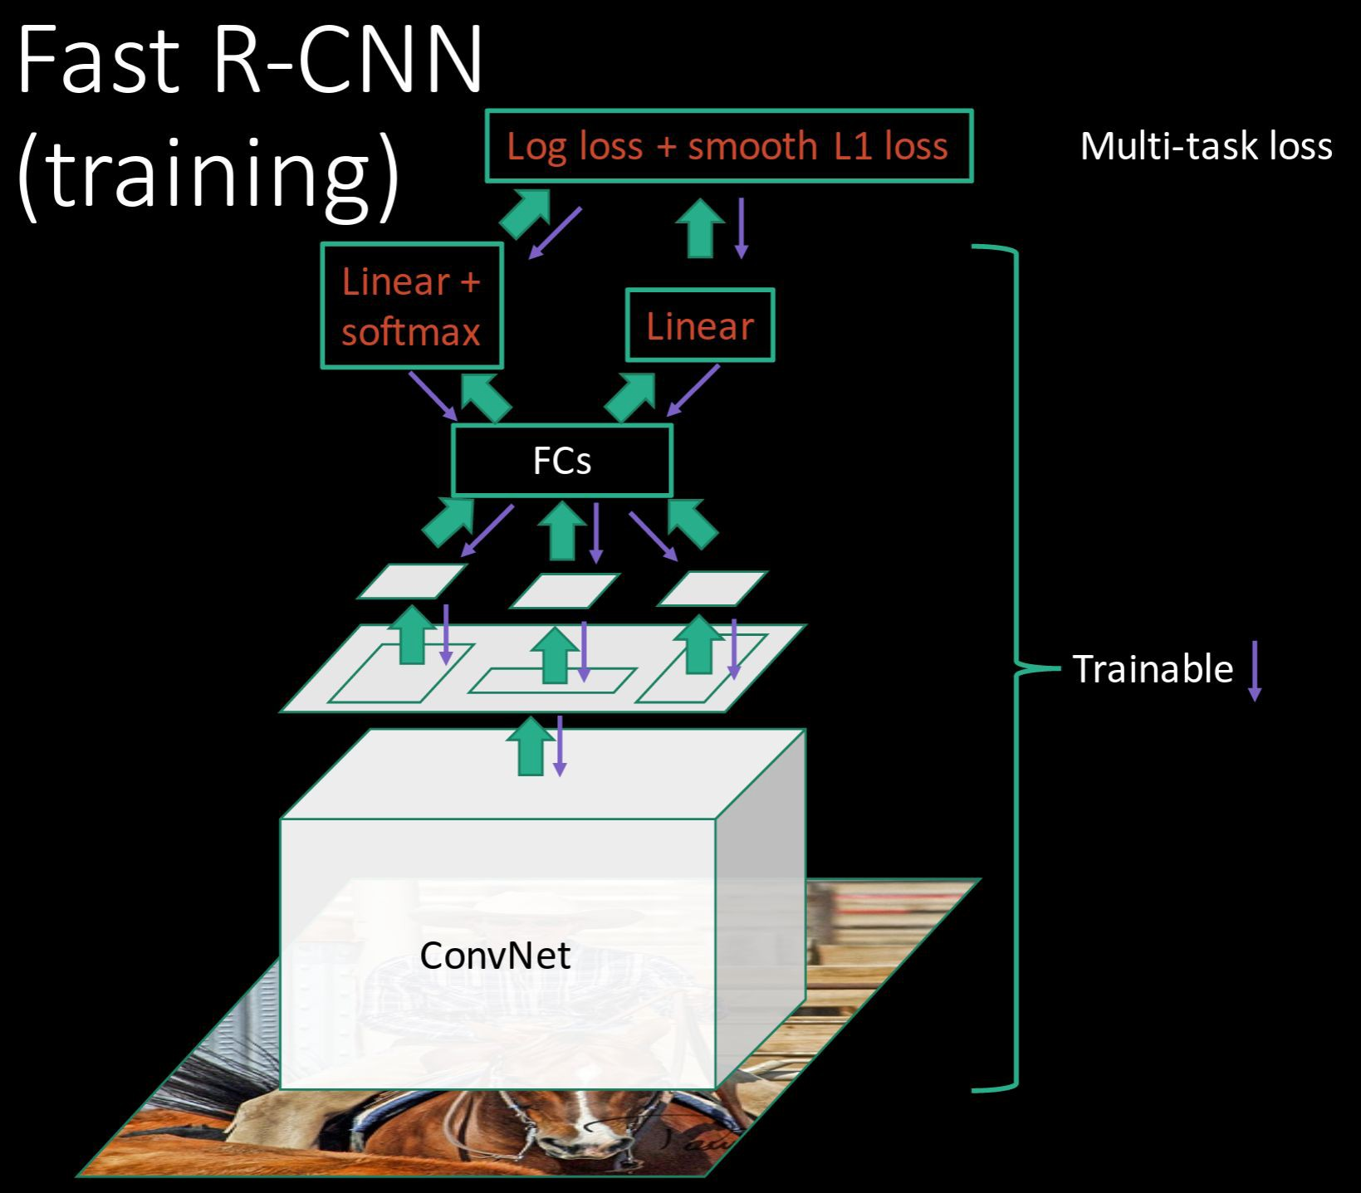
R-CNN Problem #2:
Post-hoc training: CNN not updated in response to final classifiers and regressors
R-CNN Problem #3:
Complex training pipeline
Solution:
Just train the whole system end-to-end all at once!
Slide credit: Ross Girschick
Lecture 8 - 1 Feb 2016Fei-Fei Li & Andrej Karpathy & Justin Johnson

Slide 70
Fast R-CNN: Region of Interest Pooling
Convolution and Pooling
Fully-connected layers
Hi-res input image: 3 x 800 x 600
with region proposal
Hi-res conv features:
C x H x W
with region proposal
Problem: Fully-connected layers expect low-res conv features: C x h x w
Lecture 8 - 1 Feb 2016Fei-Fei Li & Andrej Karpathy & Justin Johnson

Slide 71
Fast R-CNN: Region of Interest Pooling
Project region proposal onto conv feature map
Convolution and Pooling
Fully-connected layers
Hi-res input image: 3 x 800 x 600
with region proposal
Hi-res conv features:
C x H x W
with region proposal
Problem: Fully-connected layers expect low-res conv features: C x h x w
Lecture 8 - 1 Feb 2016Fei-Fei Li & Andrej Karpathy & Justin Johnson

Slide 72
Fast R-CNN: Region of Interest Pooling
Convolution and Pooling
Divide projected region into h x w grid
Fully-connected layers
Hi-res input image: 3 x 800 x 600
with region proposal
Hi-res conv features:
C x H x W
with region proposal
Problem: Fully-connected layers expect low-res conv features: C x h x w
Lecture 8 - 1 Feb 2016Fei-Fei Li & Andrej Karpathy & Justin Johnson

Slide 73
Fast R-CNN: Region of Interest Pooling
Max-pool within
Convolution and Pooling
each grid cell
Fully-connected layers
Hi-res input image: 3 x 800 x 600
with region proposal
Hi-res conv features:
C x H x W
with region proposal
RoI conv features:
C x h x w
for region proposal
Fully-connected layers expect low-res conv features:
C x h x w
Lecture 8 - 1 Feb 2016Fei-Fei Li & Andrej Karpathy & Justin Johnson

Slide 74
Fast R-CNN: Region of Interest Pooling
Can back propagate
Convolution and Pooling
similar to max pooling
Fully-connected layers
Hi-res input image: 3 x 800 x 600
with region proposal
Hi-res conv features:
C x H x W
with region proposal
RoI conv features:
C x h x w
for region proposal
Fully-connected layers expect low-res conv features:
C x h x w
Lecture 8 - 1 Feb 2016Fei-Fei Li & Andrej Karpathy & Justin Johnson

Slide 75
Fast R-CNN Results
 | R-CNN | Fast R-CNN
Training Time: | 84 hours | 9.5 hours
(Speedup) | 1x | 8.8x
Faster!
Using VGG-16 CNN on Pascal VOC 2007 dataset
Lecture 8 - 1 Feb 2016Fei-Fei Li & Andrej Karpathy & Justin Johnson

Slide 76
Fast R-CNN Results
 | R-CNN | Fast R-CNN
Training Time: | 84 hours | 9.5 hours
(Speedup) | 1x | 8.8x
Test time per image | 47 seconds | 0.32 seconds
(Speedup) | 1x | 146x
Faster!
FASTER!
Using VGG-16 CNN on Pascal VOC 2007 dataset
Lecture 8 - 1 Feb 2016Fei-Fei Li & Andrej Karpathy & Justin Johnson

Slide 77
Fast R-CNN Results
 | R-CNN | Fast R-CNN
Training Time: | 84 hours | 9.5 hours
(Speedup) | 1x | 8.8x
Test time per image | 47 seconds | 0.32 seconds
(Speedup) | 1x | 146x
mAP (VOC 2007) | 66.0 | 66.9
Faster!
FASTER!
Better!
Using VGG-16 CNN on Pascal VOC 2007 dataset
Lecture 8 - 1 Feb 2016Fei-Fei Li & Andrej Karpathy & Justin Johnson

Slide 78
Fast R-CNN Problem:
Test-time speeds don’t include region proposals
 | R-CNN | Fast R-CNN
Test time per image | 47 seconds | 0.32 seconds
(Speedup) | 1x | 146x
Test time per image with Selective Search | 50 seconds | 2 seconds
(Speedup) | 1x | 25x
Lecture 8 - 1 Feb 2016Fei-Fei Li & Andrej Karpathy & Justin Johnson

Slide 79
Fast R-CNN Problem Solution:
Test-time speeds don’t include region proposals Just make the CNN do region proposals too!
 | R-CNN | Fast R-CNN
Test time per image | 47 seconds | 0.32 seconds
(Speedup) | 1x | 146x
Test time per image with Selective Search | 50 seconds | 2 seconds
(Speedup) | 1x | 25x
Lecture 8 - 1 Feb 2016Fei-Fei Li & Andrej Karpathy & Justin Johnson

Slide 80
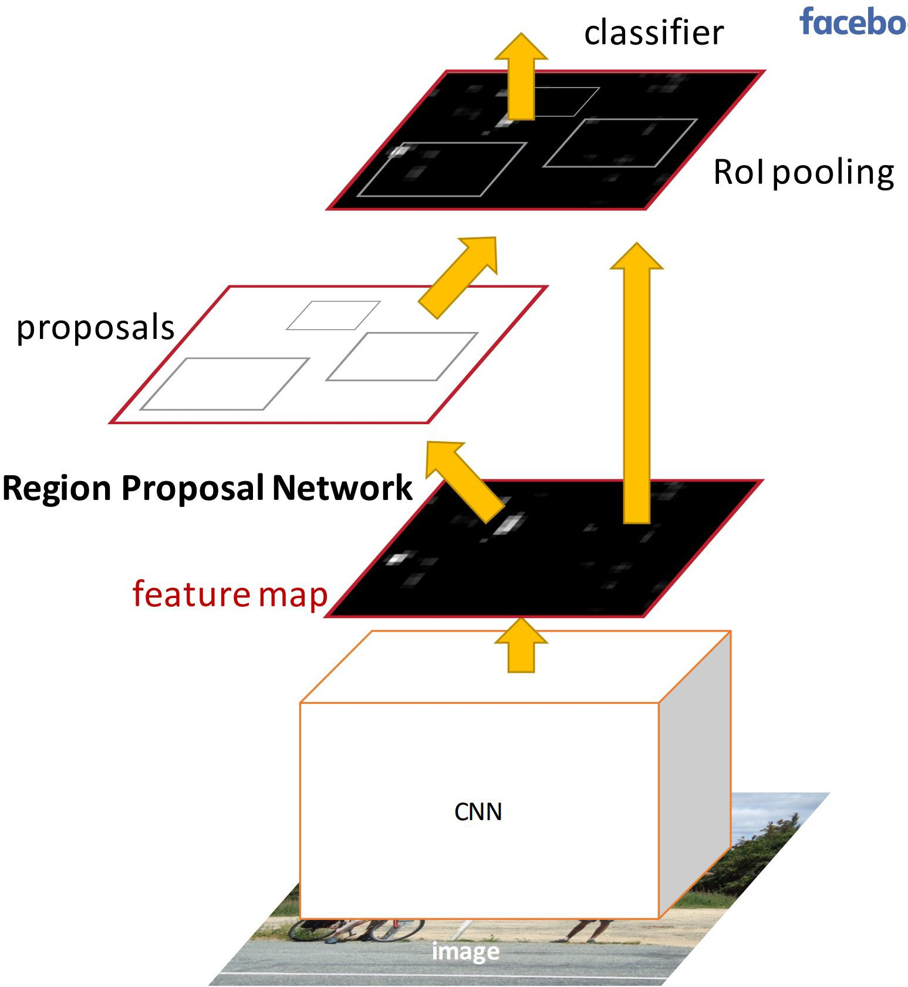
Faster R-CNN:
Insert a Region Proposal Network (RPN) after the last convolutional layer
RPN trained to produce region proposals directly; no need for external region proposals!
After RPN, use RoI Pooling and an upstream classifier and bbox regressor just like Fast R-CNN
Ren et al, “Faster R-CNN: Towards Real-Time Object Detection with Region Proposal Networks”, NIPS 2015
Slide credit: Ross Girschick
Lecture 8 - 1 Feb 2016Fei-Fei Li & Andrej Karpathy & Justin Johnson

Slide 81
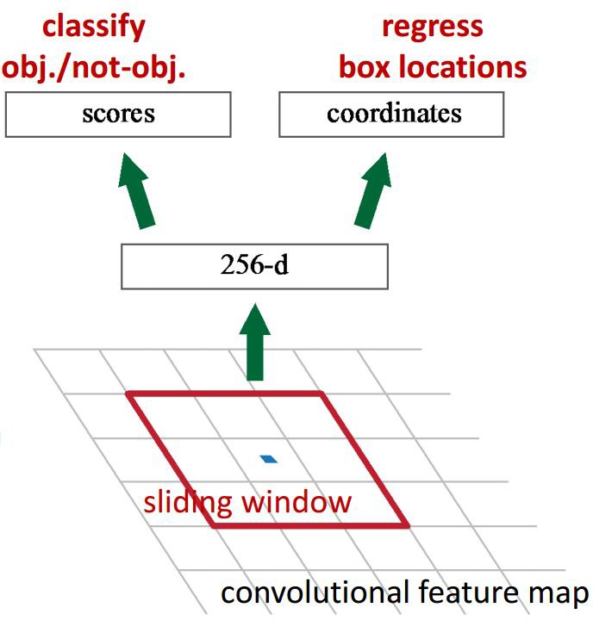
Faster R-CNN: Region Proposal Network
Slide a small window on the feature map
Build a small network for:
classifying object or not-object, and
regressing bbox locations
1 x 1 conv
1 x 1 conv
1 x 1 conv
Position of the sliding window provides localization information with reference to the image
Box regression provides finer localization information with reference to this sliding window
Slide credit: Kaiming He
Lecture 8 - 1 Feb 2016Fei-Fei Li & Andrej Karpathy & Justin Johnson

Slide 82
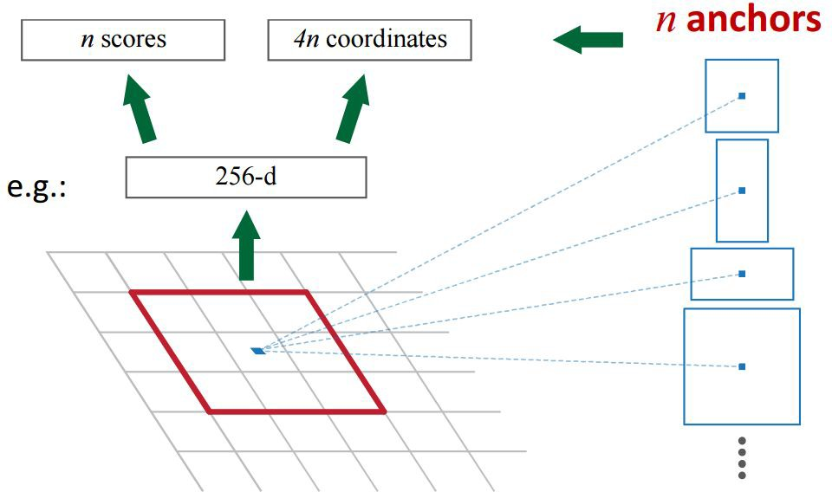
Faster R-CNN: Region Proposal Network
Use N anchor boxes at each location
Anchors are translation invariant: use the same ones at every location
Regression gives offsets from anchor boxes
Classification gives the probability that each (regressed) anchor shows an object
Lecture 8 - 1 Feb 2016Fei-Fei Li & Andrej Karpathy & Justin Johnson

Slide 83
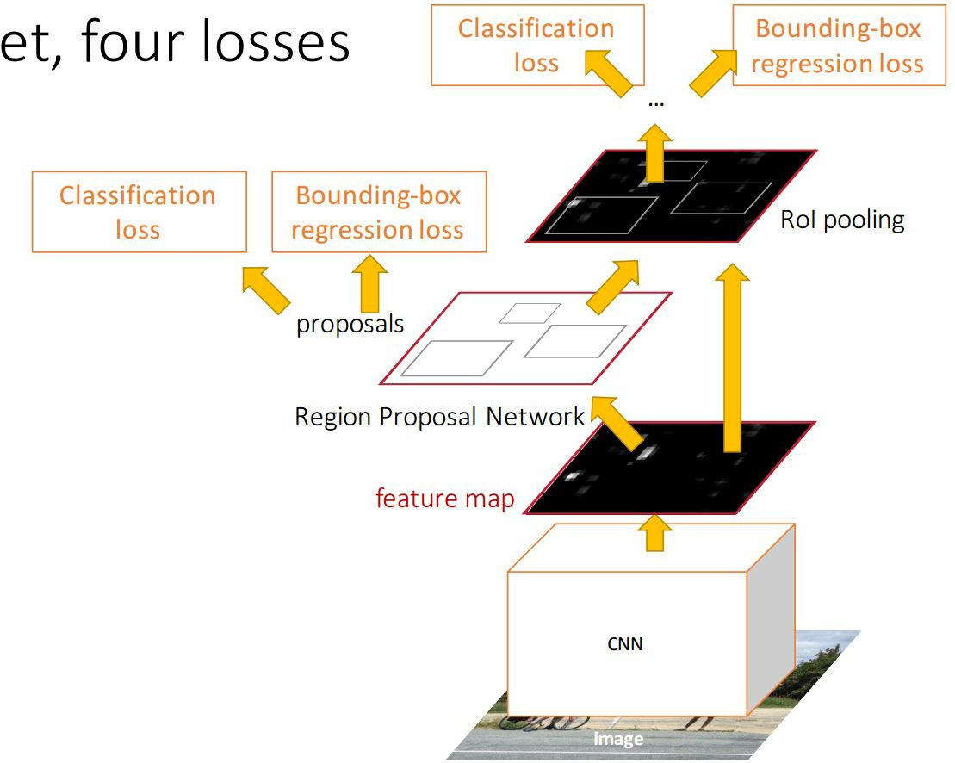
Faster R-CNN: Training
In the paper: Ugly pipeline
Use alternating optimization to train RPN, then Fast R-CNN with RPN proposals, etc.
More complex than it has to be
Since publication: Joint training! One network, four losses
RPN classification (anchor good / bad)
RPN regression (anchor -> proposal)
Fast R-CNN classification (over classes)
Fast R-CNN regression (proposal -> box)
Slide credit: Ross Girschick
Lecture 8 - 1 Feb 2016Fei-Fei Li & Andrej Karpathy & Justin Johnson

Slide 84
Faster R-CNN: Results
 | R-CNN | Fast R-CNN | Faster R-CNN
Test time per image (with proposals) | 50 seconds | 2 seconds | 0.2 seconds
(Speedup) | 1x | 25x | 250x
mAP (VOC 2007) | 66.0 | 66.9 | 66.9
Lecture 8 - 1 Feb 2016Fei-Fei Li & Andrej Karpathy & Justin Johnson

Slide 85
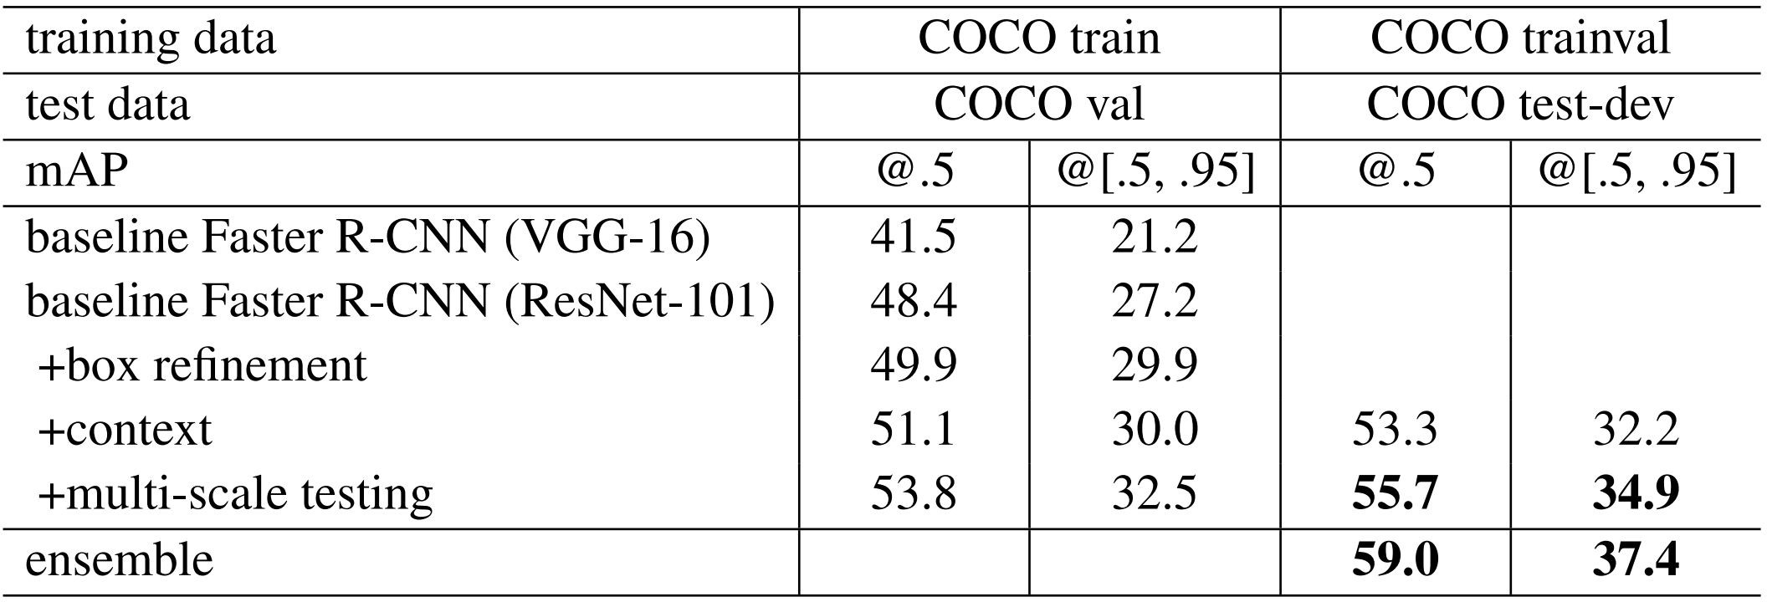
Object Detection State-of-the-art:
ResNet 101 + Faster R-CNN + some extras
He et. al, “Deep Residual Learning for Image Recognition”, arXiv 2015
Lecture 8 - 1 Feb 2016Fei-Fei Li & Andrej Karpathy & Justin Johnson

Slide 86

ImageNet Detection 2013 - 2015
Lecture 8 - 1 Feb 2016Fei-Fei Li & Andrej Karpathy & Justin Johnson

Slide 87


YOLO: You Only Look Once Detection as Regression
Divide image into S x S grid
Within each grid cell predict:
B Boxes: 4 coordinates + confidence Class scores: C numbers
Regression from image to 7 x 7 x (5 * B + C) tensor
Direct prediction using a CNN
Redmon et al, “You Only Look Once:
Unified, Real-Time Object Detection”, arXiv 2015
Lecture 8 - 1 Feb 2016Fei-Fei Li & Andrej Karpathy & Justin Johnson

Slide 88

YOLO: You Only Look Once Detection as Regression
Faster than Faster R-CNN, but not as good
Redmon et al, “You Only Look Once:
Unified, Real-Time Object Detection”, arXiv 2015
Lecture 8 - 1 Feb 2016Fei-Fei Li & Andrej Karpathy & Justin Johnson

Slide 89
Object Detection code links:
R-CNN
(Cafffe + MATLAB): https://github.com/rbgirshick/rcnn Probably don’t use this; too slow
Fast R-CNN
(Caffe + MATLAB): https://github.com/rbgirshick/fast-rcnn
Faster R-CNN
(Caffe + MATLAB): https://github.com/ShaoqingRen/faster_rcnn (Caffe + Python): https://github.com/rbgirshick/py-faster-rcnn
YOLO
http://pjreddie.com/darknet/yolo/ Maybe try this for projects?
Lecture 8 - 1 Feb 2016Fei-Fei Li & Andrej Karpathy & Justin Johnson

Slide 90
Recap
Localization:
Find a fixed number of objects (one or many)
L2 regression from CNN features to box coordinates
Much simpler than detection; consider it for your projects!
Overfeat: Regression + efficient sliding window with FC -> conv conversion
Deeper networks do better
Object Detection:
Find a variable number of objects by classifying image regions
Before CNNs: dense multiscale sliding window (HoG, DPM)
Avoid dense sliding window with region proposals
R-CNN: Selective Search + CNN classification / regression
Fast R-CNN: Swap order of convolutions and region extraction
Faster R-CNN: Compute region proposals within the network
Deeper networks do better
Lecture 8 - 1 Feb 2016Fei-Fei Li & Andrej Karpathy & Justin Johnson

